Slide 1
PUBLICATE
A decentralised censorship resistant social media on the ethereum blockchain.

Slide 2
TABLE OF CONTENTS
01
04
About the Project
Meachanism
02
05
Block Chain & Web 3.0
Initial Goals
03
06
Need of Publicate
Towards Success
What is Publicate ? Fundamentals
How does it work
What is Block chain
Aim to reach masses
Why Publicate?
Future plans and Goals

Slide 3
ABOUT THE PROJECT
PUBLICATE
A completely decentralized social media platform which works on the principles of block chain , No restrictions , censorship with full freedom for everything the users wants , needs.

Slide 4
—SOMEONE FAMOUS
“The only way to control chaos and complexity is to give up some of that control”

Slide 5
What is WEB 3.0?
Web 2.0 and Web 3.0 refer to successive iterations of the web, compared with the original Web 1.0 of the 1990s and early 2000s. Web 2.0 is the current version of the internet with which we are all familiar, while Web 3.0 represents its next phase.

Slide 6
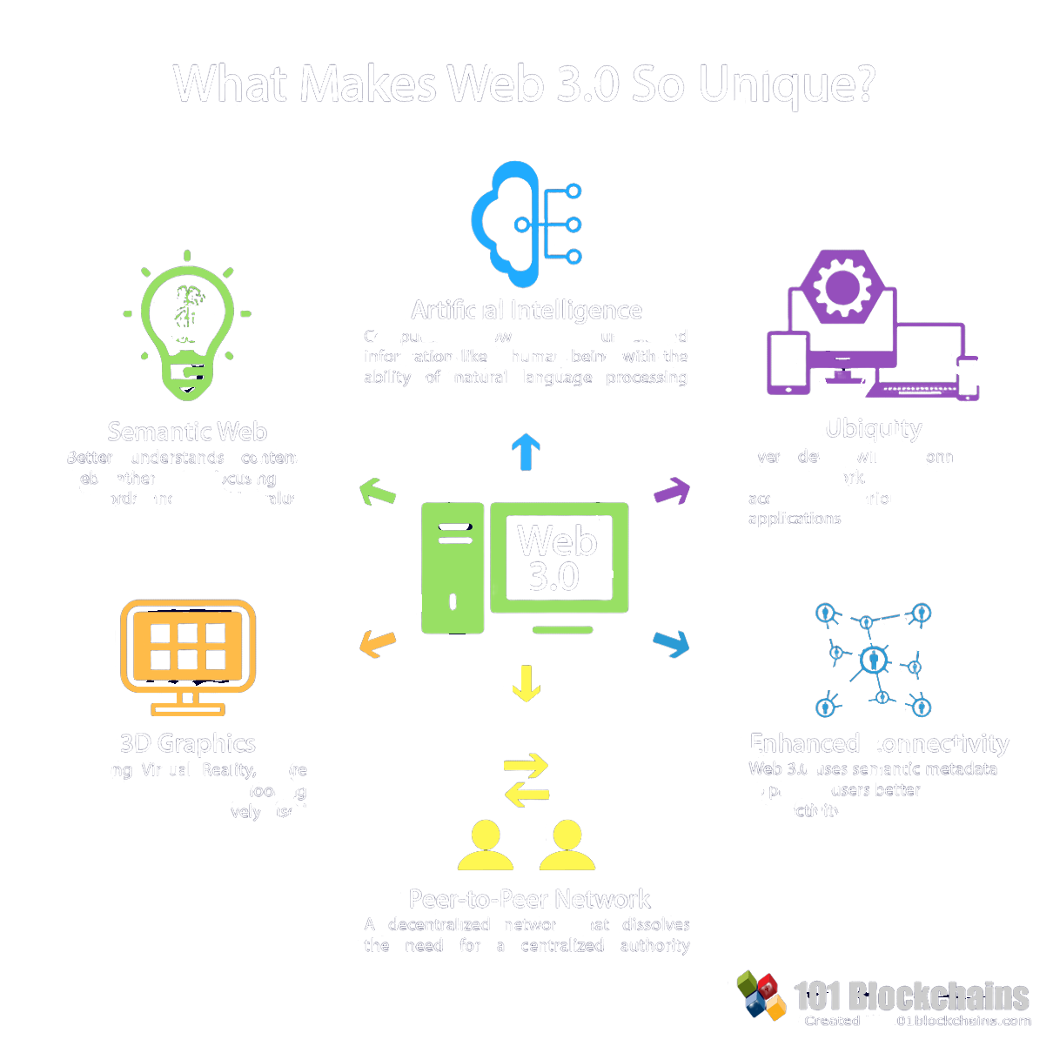
Defining Features of Web 3.0
Computers now can understand information like a human being with the ability of natural language processing.
Better understands contents webh rather than focusing on keywords and numeric values.
Every device will be connected to the network. Contents can be accessible by various applications.
c
Utilizing Virtual reality, more realistic and natural looking graphics are extensively used.
Web 3.0 uses semantic metadata to provide users better connectivity.
A Decentralised network that dissolves the need for a centralised authority.

Slide 7
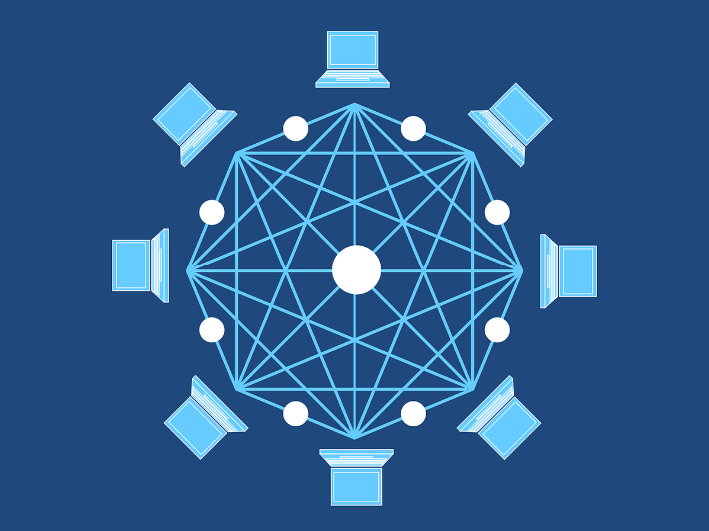
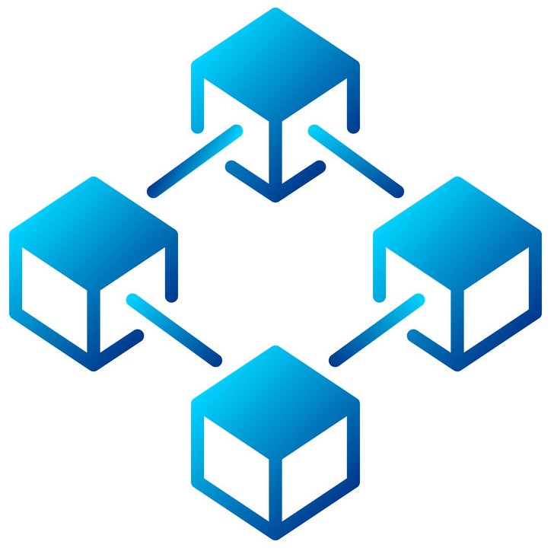
What is Block Chain?
Blockchain is a system of recording information in a way that makes it difficult or impossible to change, hack, or cheat the system. A Blockchain is essentially a digital ledger of transactions that is duplicated and distributed across the entire network of computer systems on the Blockchain

Slide 8
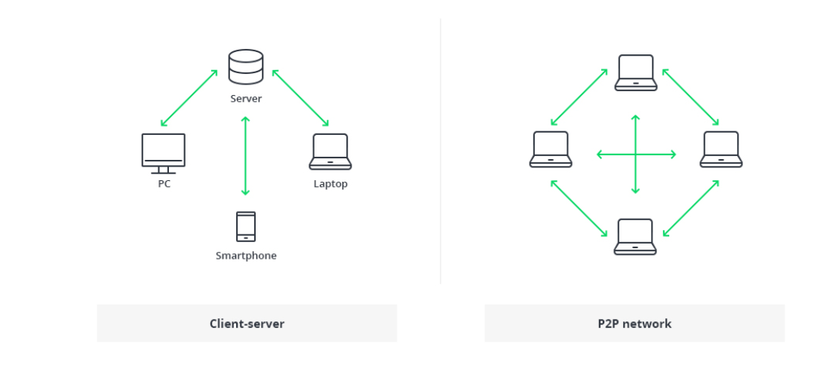
Database VS Blockchain Architecture

Slide 9
Current Scenario
RESTRICTIONS ON VARIOUS PLATFORM
TOP LEADERS MANIPULATE INFORMATION
LACK OF PRIVACY

Slide 10
Our Mission
NO RESTRICTIONS OR CENSORSHIP
USERS CONTROL EVERYTHING
SAFE & SECURE BASED ON WEB 3.0

Slide 11
What is PUBLICATE?
It is a decentralized Blockchain Social Media platform that allow the development of applications and smart contracts. The significant benefit of such platform is that it offers end-to-end encryptions for every interaction enabling individuals to have more privacy and control over their information. PUBLICATE can provide some major benefits like In-platform transactions, Crowdfunding, and Rewarding their users with exclusive offers.

Slide 12
The Main Difference
The traditional architecture of the World Wide Web uses a client-server network. In this case, the server keeps all the required information in one place so that it is easy to update, due to the server being a centralized database controlled by a number of administrators with permissions.
In the case of the distributed network of Blockchain architecture, each participant within the network maintains, approves, and updates new entries. The system is controlled not only by separate individuals, but by everyone within the Blockchain network. Each member ensures that all records and procedures are in order, which results in data validity and security. Thus, parties that do not necessarily trust each other are able to reach a common consensus.

Slide 13
Mechanism and Interface
The entire project is based on the principles of Web 3.0 and Blockchain which will be next big talks in the internet world . We all know about cryptocurrency which is based on Blockchain system in the same way PUBLICATE uses Blockchain architecture to provide the users with all the freedom they could have on internet with highest level of privacy and No restrictions on their views.
More about the our site (backend coding) can be viewed on the below link -:
https://github.com/jashanpratapsingh/publicate.git

Slide 14
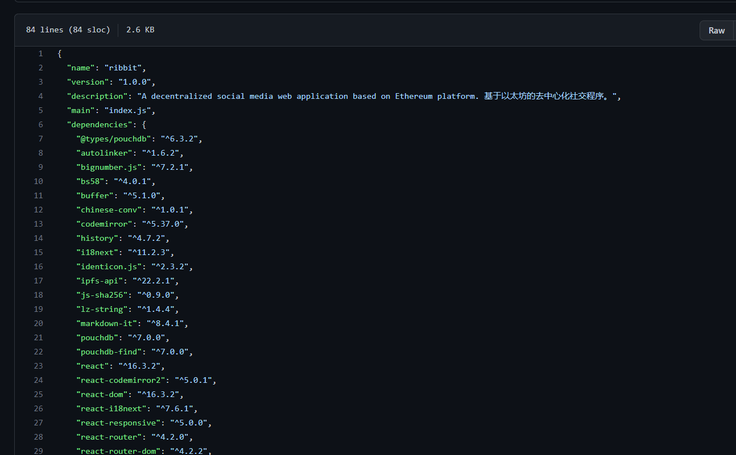
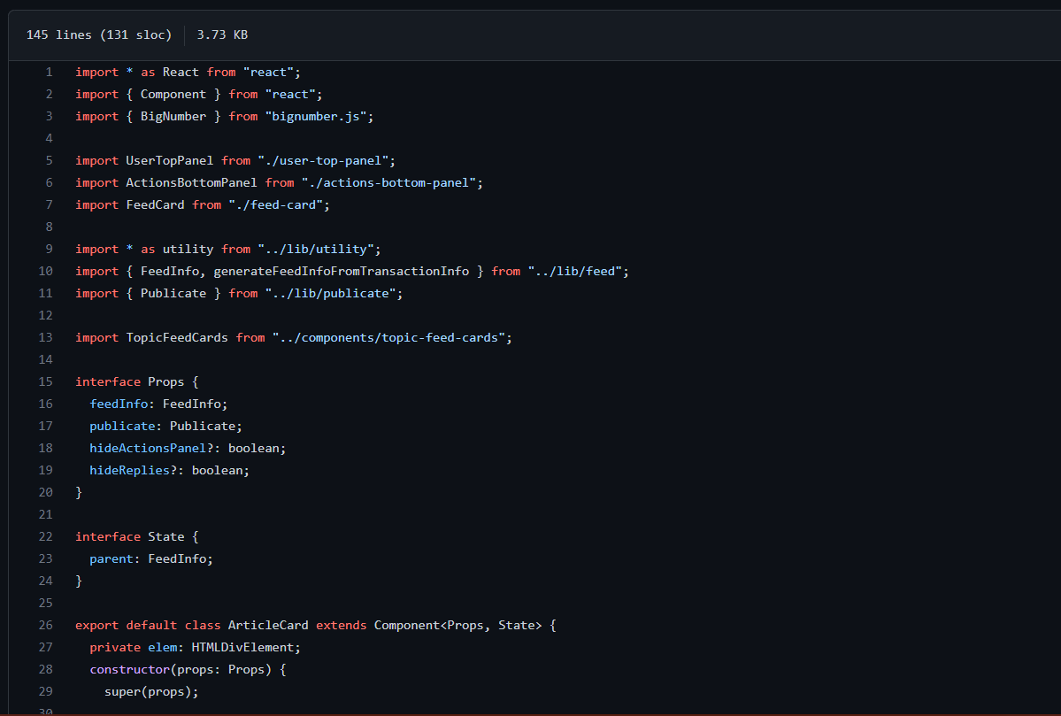
Mechanism and Interface

Slide 15
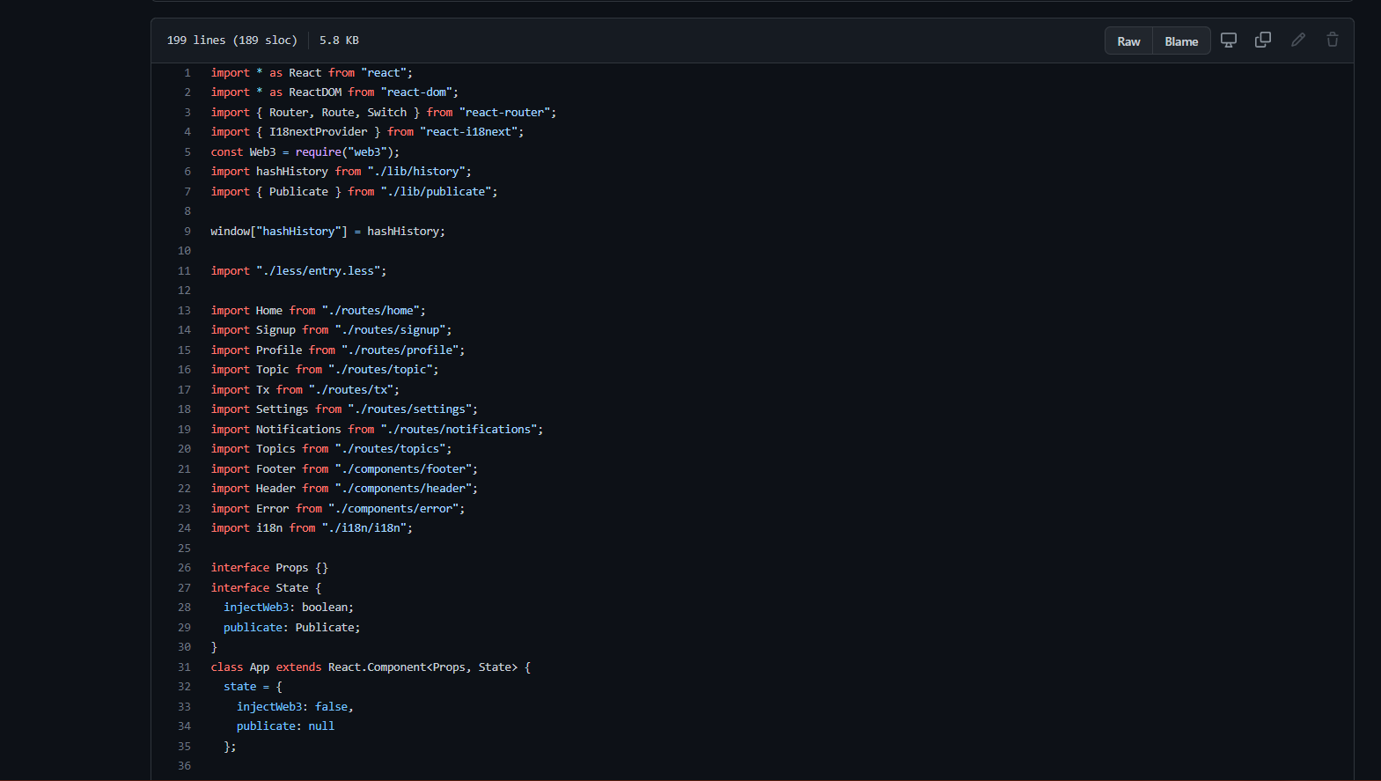
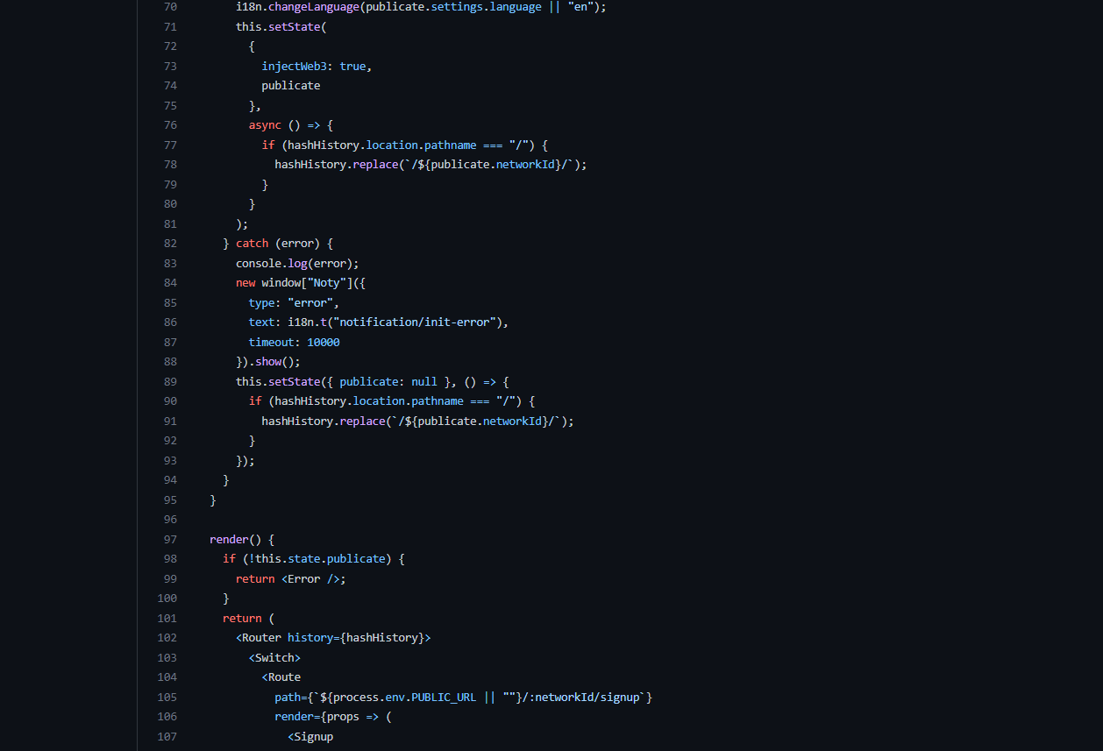
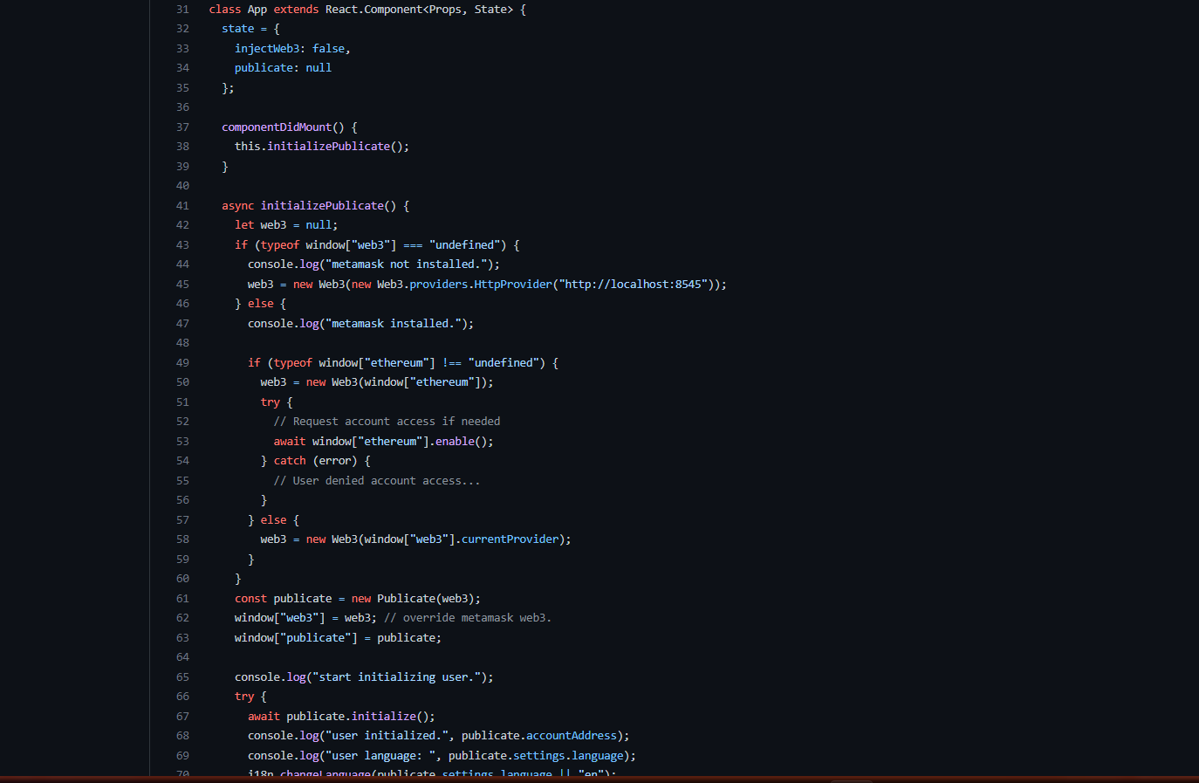
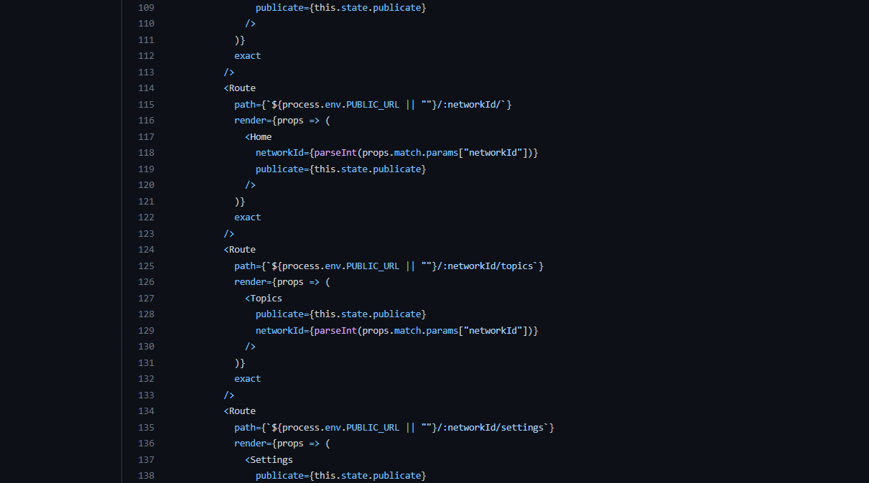

Slide 16
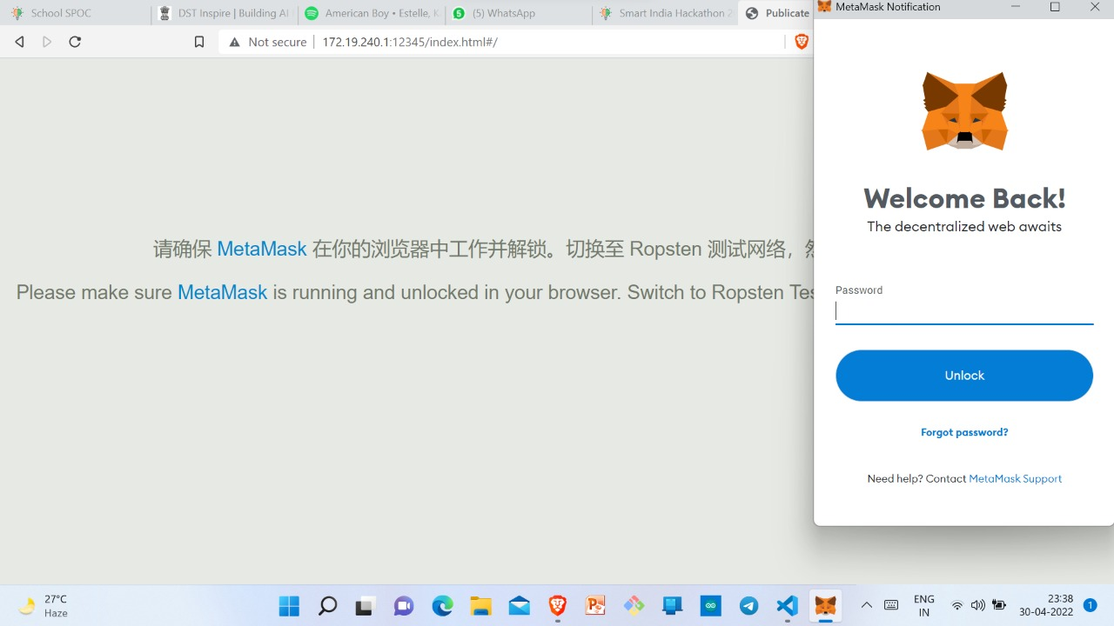
Mechanism and Interface
Login Credentials
Works on Blockchain
Principles

Slide 17
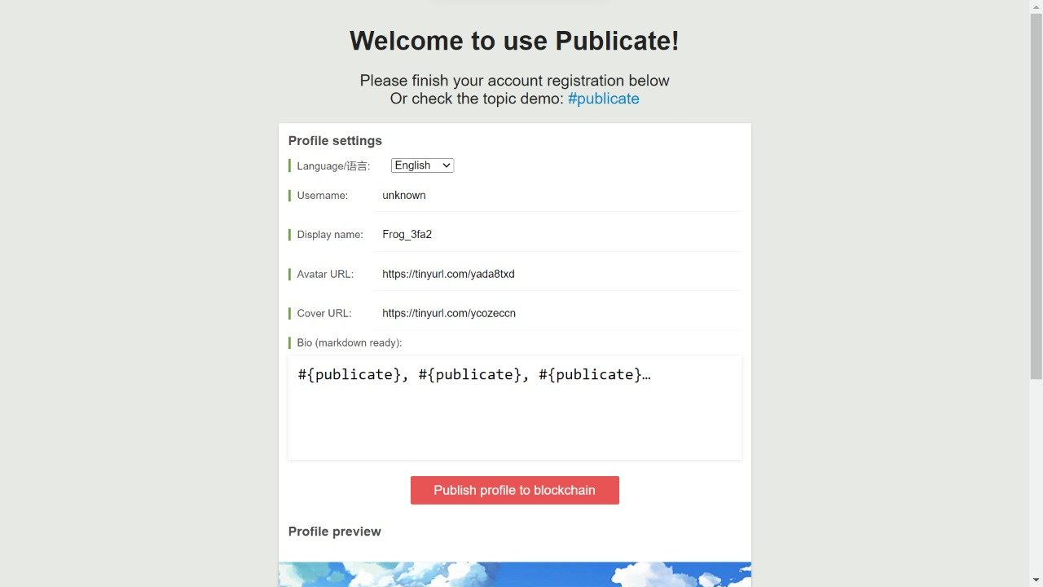
Mechanism and Interface
Welcome Page

Slide 18
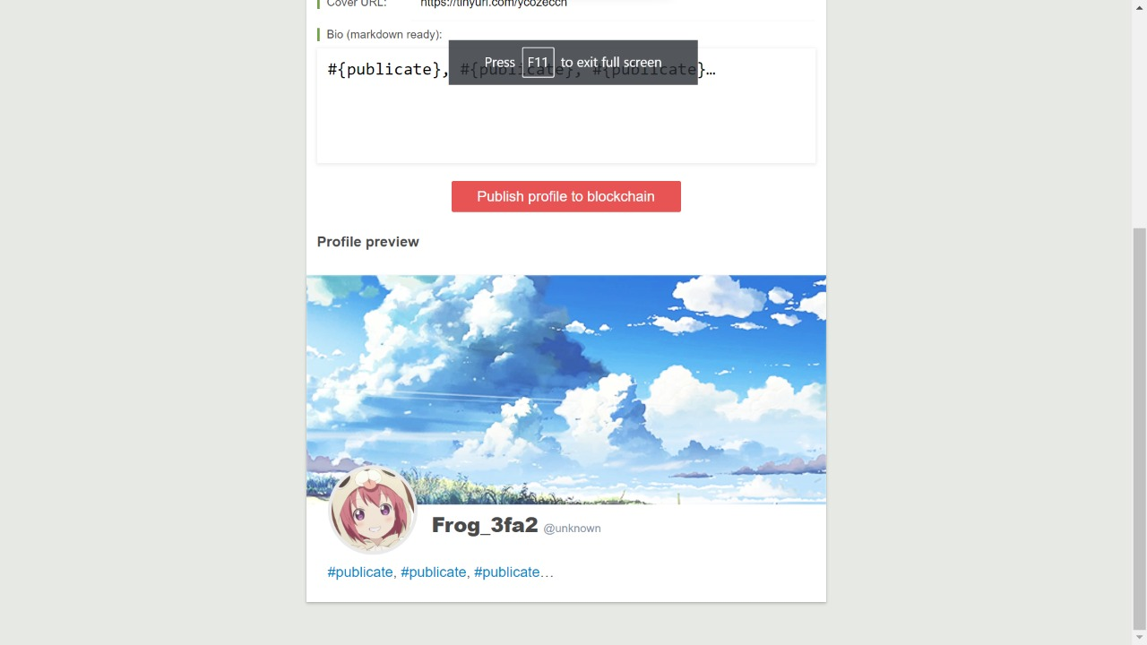
Mechanism and Interface
User Profile

Slide 19
OUR TIMELINE
Build Community
Initial stage
BETA
RELEASE
FINAL
VERSION
Reach masses
Improve networks and reach
Build a strong and Healthy Communty
Suggestions
Improve and include everyone
Reach every corner of the world

Slide 20
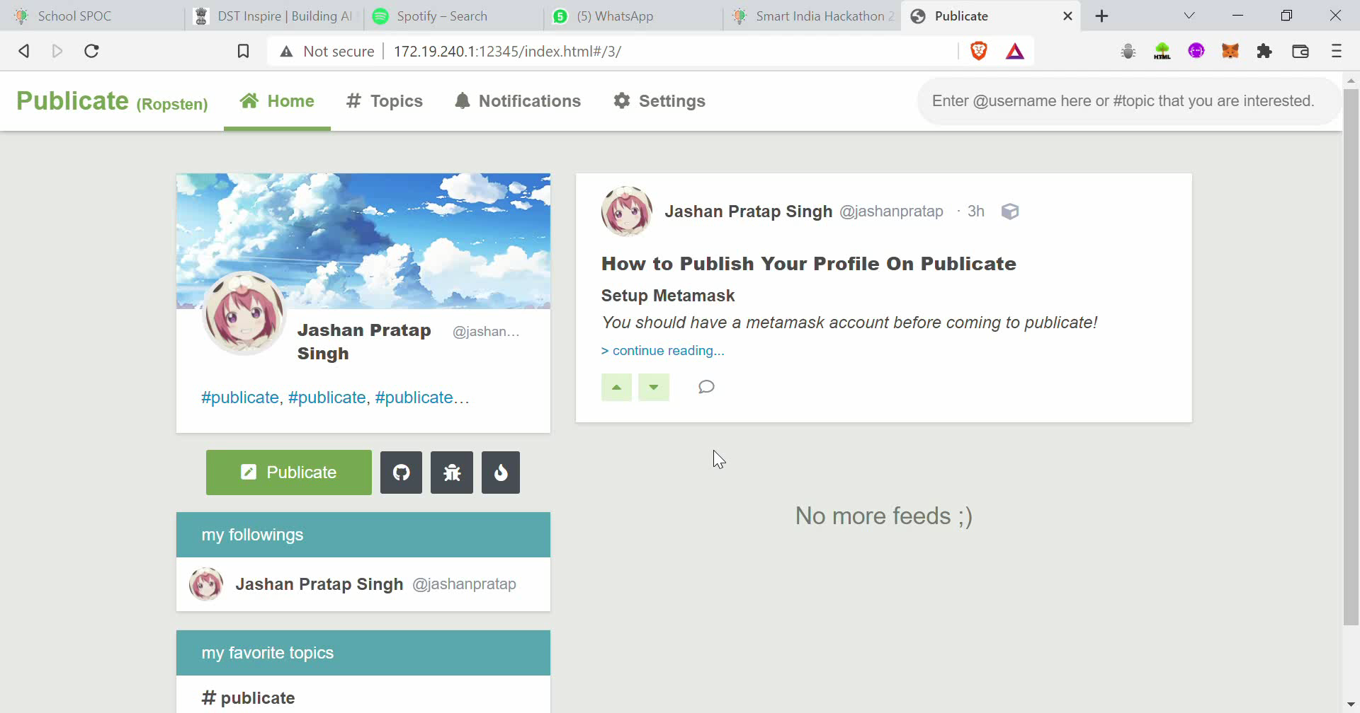
Video for the project.

Slide 21
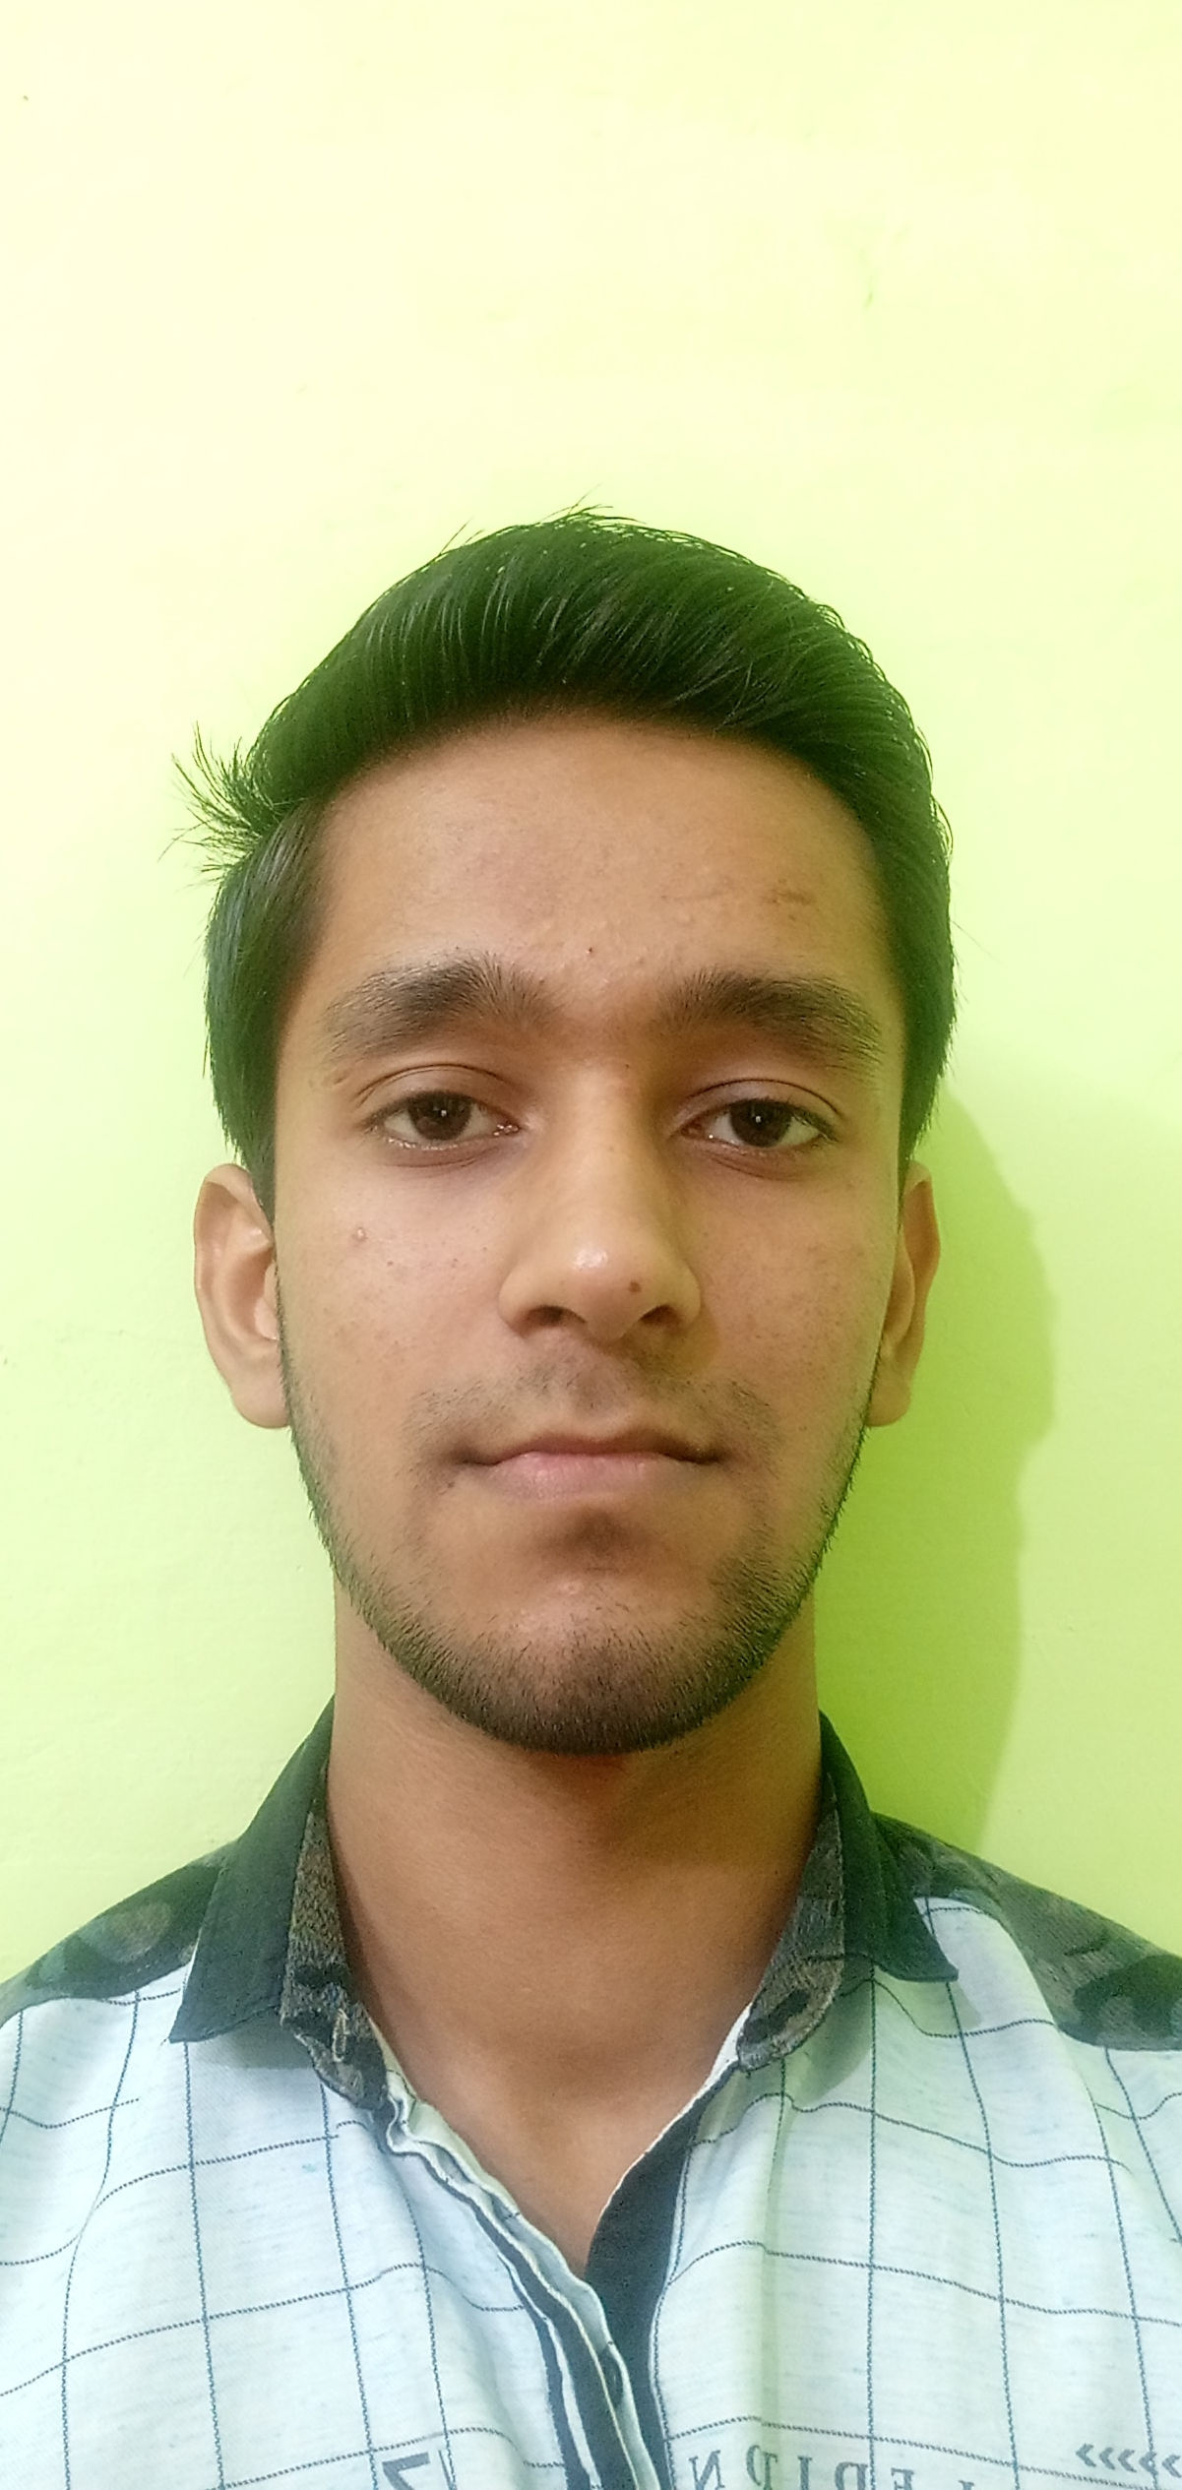
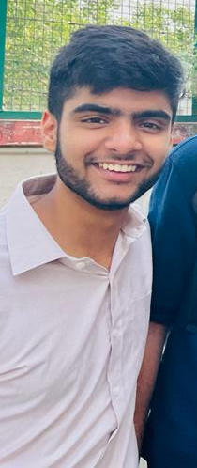
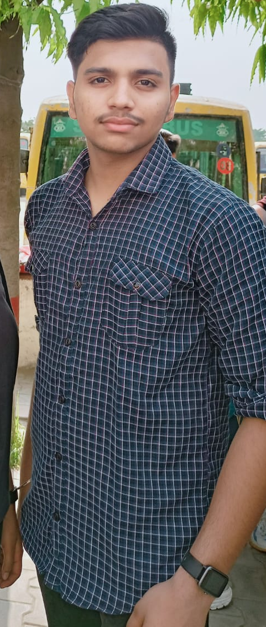
THE TEAM
Anshul Shukla
Jashan Pratap Singh
Aayush Pratap Singh

Slide 22
THANKS!

